Slide 1
API-STD-2RD Methods
29th Sept 2018

Slide 2
Introduction
API STD 2RD Methods

Slide 3
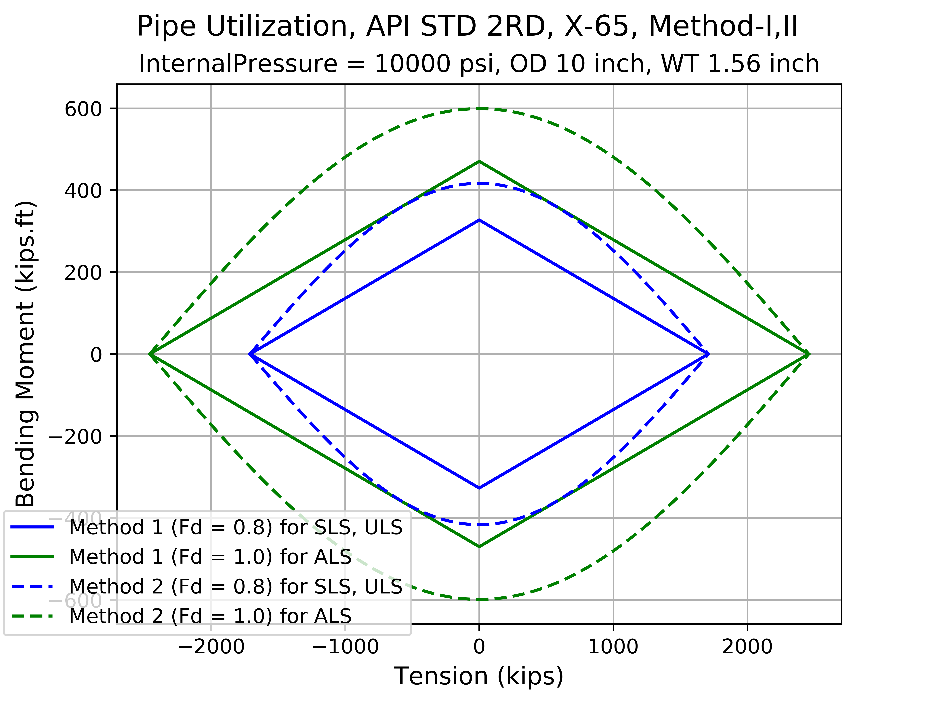
10 inch OD

Slide 4
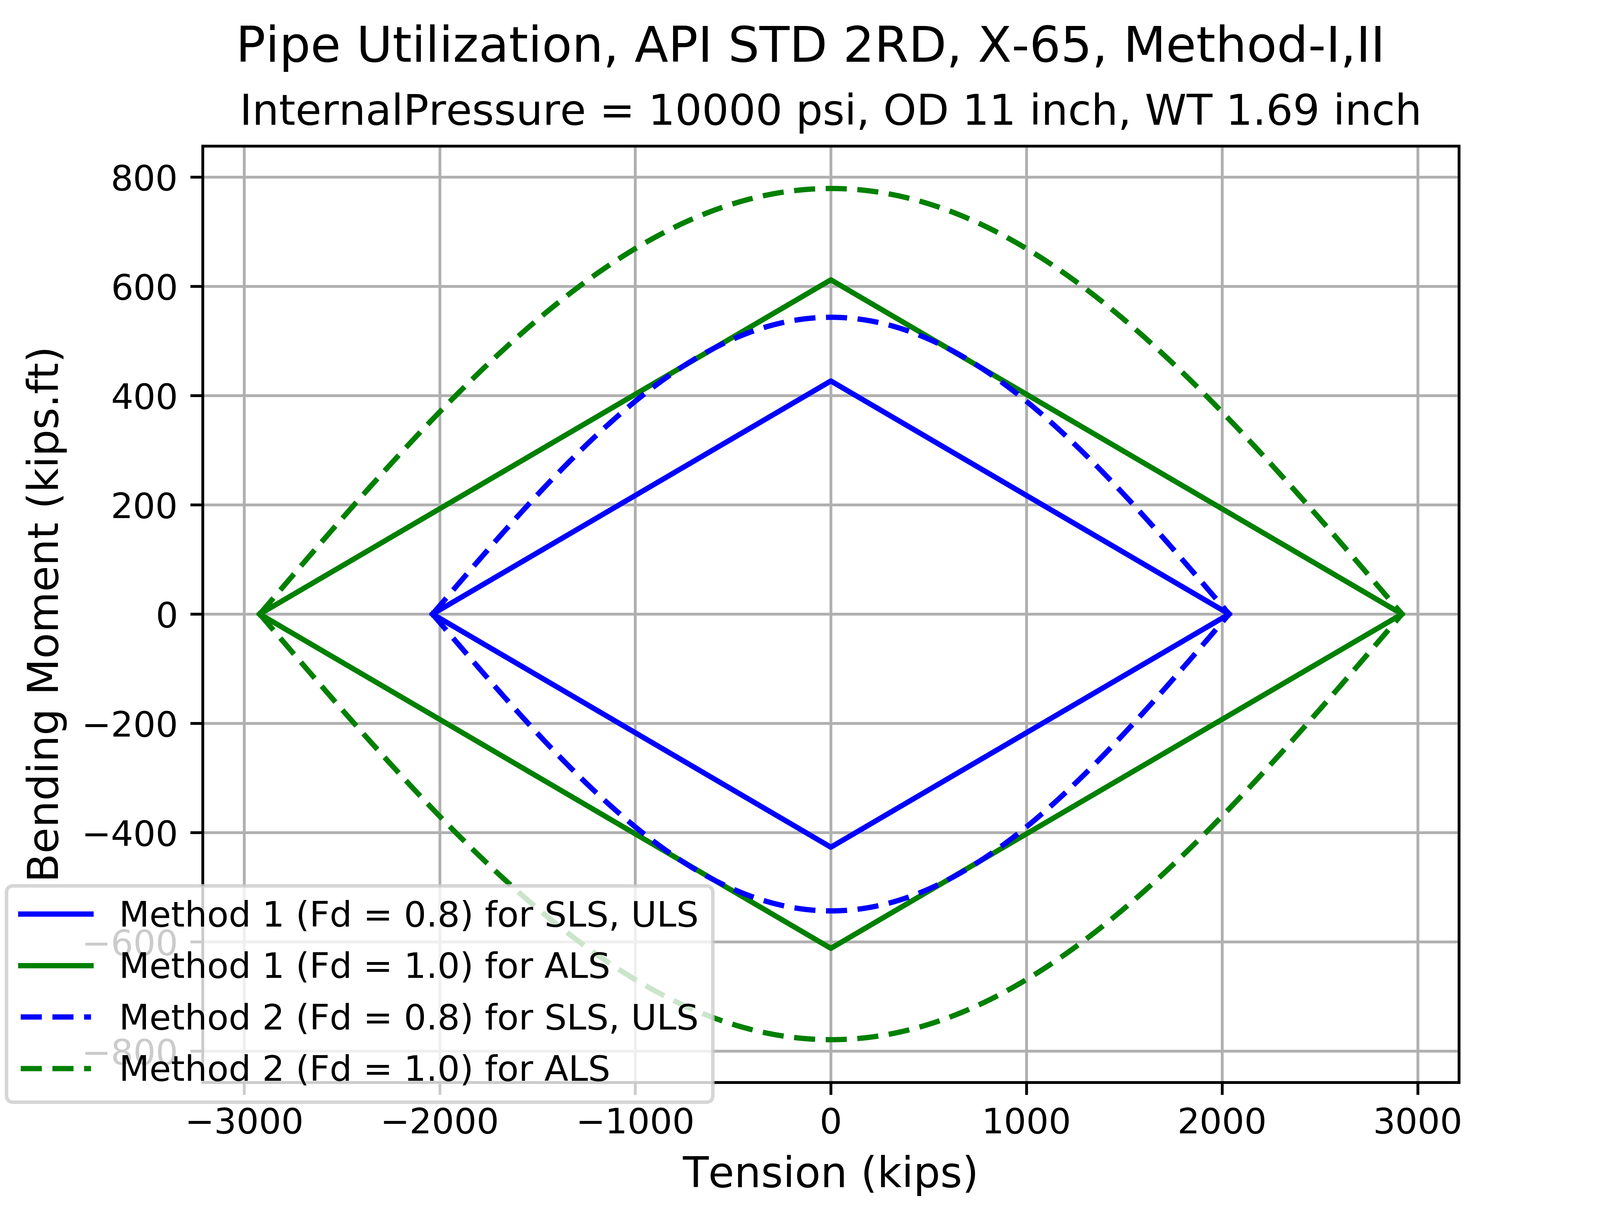
11 inch OD

Slide 5
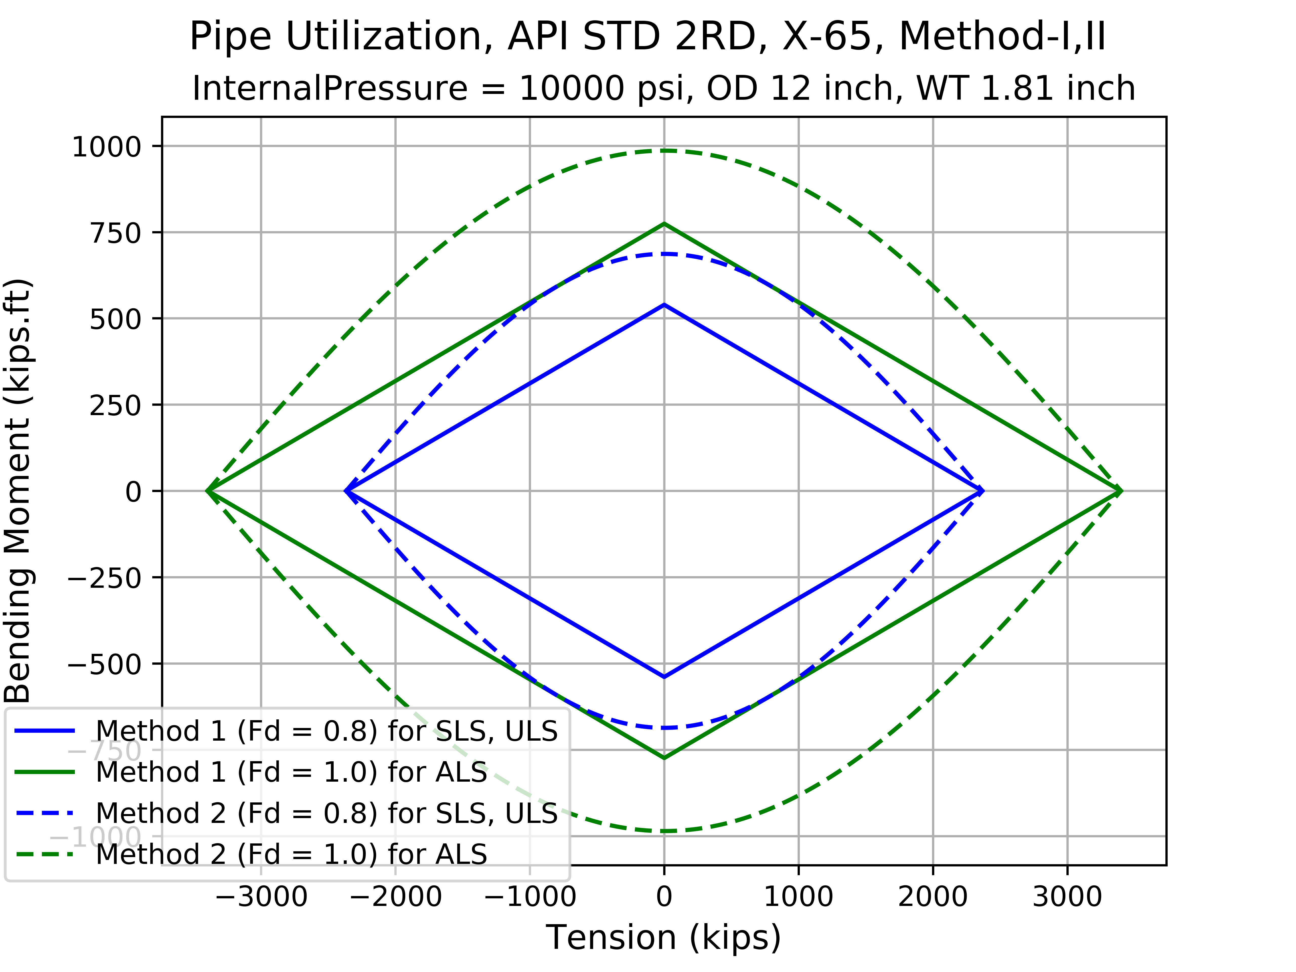
12 inch OD

Slide 6

14 inch OD

Slide 7

16 inch OD

Slide 8
Way Forward

Slide 9
THANK YOU
For the opportunity to serve!

Slide 10
Document Revision History
01 | New Document | 28th June 2017 |  | VK
Rev | Description | Date |  | Author | Checked | Approved
Document No: |  |  | Client Ref:

